Slide 1
Housing Assistance Owners
Analysis

Slide 2
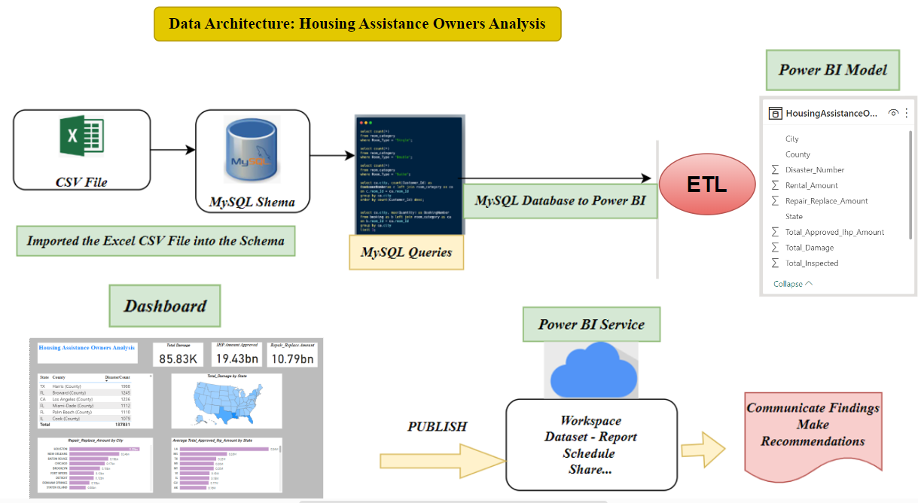

Slide 3
Data Explanation
The main was to understand the data and answer business questions.
The dataset has:
9 Columns (state, city, county, disaster_number, disaster_amount, repair_replace_amount, total_approved_IHP_amount, total_damage, total_inspected)
137832 Rows.

Slide 4
Business Questions to Answer
What is the total IHP (Individual and Household Program) amount approved?
What is the average total approved amount to the disaster for different states? Are there regions that tend to receive more funding relative to the disaster's severity?
Are there specific states that frequently experience disasters?
Which city has the higher repair/replace funding?
Which states are more prone to damages?

Slide 5
Process
The first step was to clean the excel csv file (remove duplicates, formatting the data)
In MySQL workbench, I created the schema: “House Assistance” and imported the excel csv file in the schema’s tables.
The business questions has been answered by writing SQL queries

Slide 6
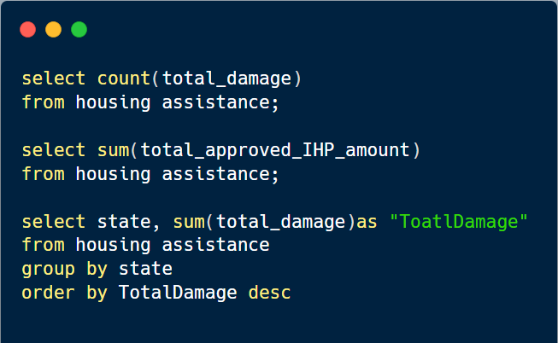
SQL Queries

Slide 7
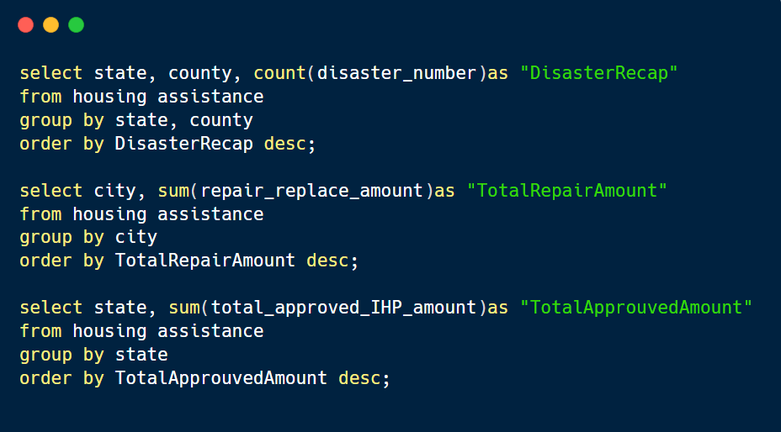
SQL Queries

Slide 8
MYSQL Database to Power BI
In Power BI, I accessed the data using MySQL Database.
I used the power query to transform and load the data.
Some Dax functions such as Sum. Count, Average is been used to answer questions.
And here is the outcome:

Slide 9
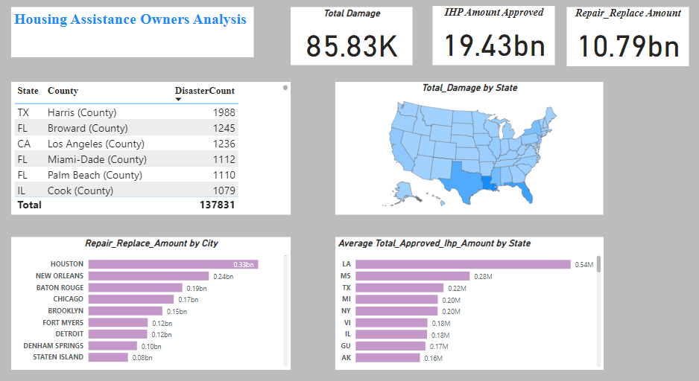
Dashboard

Slide 10
Findings
Overall,
We counted 85.83K total damage; $19.43Bn has been funded for IHP and $10.79Bn for repair/replace.
The average total approved IHP amount is 0.62M and Louisiana is the state that received more fund ($0.54M) relative to the disaster severity.
Louisiana has the majority of damage follow by Texas and Florida.
The states that frequently experience disaster are Texas, California and Florida
Houston is the city that received more fund for repair and replacement.

Slide 11
Thanks For reading
Don’t forget to comment and add more insights!

